Slide 1

World Cup Simulator
Navigating the World Cup Simulator User Interface

Slide 2
World Cup Backstory
Since its first event in 1930, in Uruguay, it has since turned into a global phenomenon that enthralls football (soccer) fans every four years.
All the world’s 207 national teams are split up into six regions. Over a roughly two-year period, they compete in regional qualifying tournaments to earn one of the 32 spots at the World Cup. The host of the tournament receives an automatic spot, even if it does not have a particularly good team.
FIFA, football's (soccer) governing body, is made up of six semi-autonomous regional bodies that help govern their respective areas. These regional bodies administer the qualifying tournaments for the World Cup. FIFA gives regions with more and better national teams a greater number of spots. That is why the tournament has fewer teams from Asia or Africa than Europe.
The qualifying 32 teams are divided into eight groups of four — labeled Groups A through H — by a random, though seeded, draw.
Once the group stage begins, the teams compete in a round-robin format, where each country plays the other three in the group just once. A win is worth 3 points; a tie, 1 point; and a loss, 0.
The top two teams (highest point totals) at the end of those three games move on to the knockout rounds.

Slide 3
Backstory continued…
In the group stage, a team could tie a game, or even lose, but still play on. However, in the knockout rounds (games played after group stage), the losing team is eliminated from the entire tournament while the winner goes to the next round.
A football (soccer) game has two halves, each 45 minutes long, for a total of a 90-minutes game (plus “stoppage time” for injuries and substitutions, at the referees’ discretion).
If the scores are tied at the end of the game, in the knockout rounds, game goes into a 30-minutes overtime (two 15 minutes games); if both sides remain tied after that, they go to penalty kicks.
The winning teams from group stage move on to round of 16, which then turns into a quarterfinal, which leads to semifinal, and ultimately leading to the biggest game: The World Cup final.
The losers of the two semifinal games play each other before the final to determine who comes in third place.

Slide 4
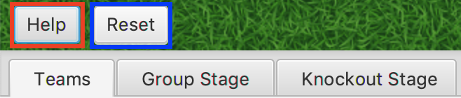
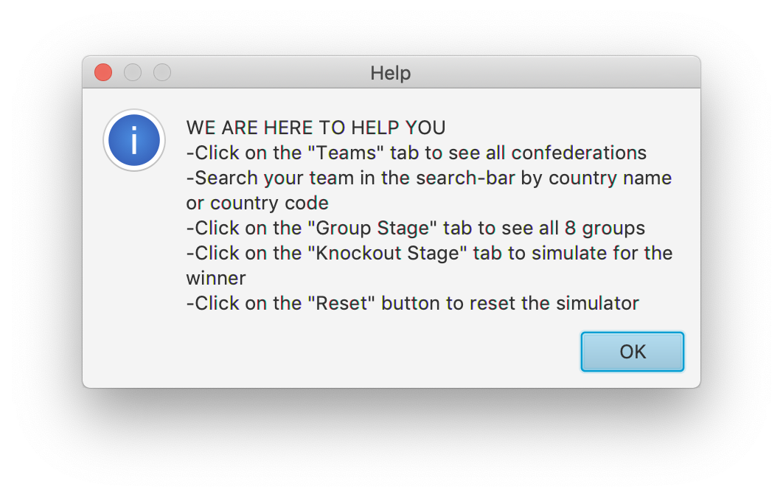
Starting the Simulator
Upon hitting the “Start” button you will see two buttons in the top left corner of the application along with three different tabs to chose form
The “Help” button displays a window briefly explaining how to navigate the application
The “Reset” button will restart simulation and go back to the “Teams” tab no matter where you were previously
The “Teams” tab displays information about all the national teams
The “Group Stage” tab displays information about the groups stage in the World Cup
The “Knockout Stage” displays information about the knockout stage in the World Cup

Slide 5

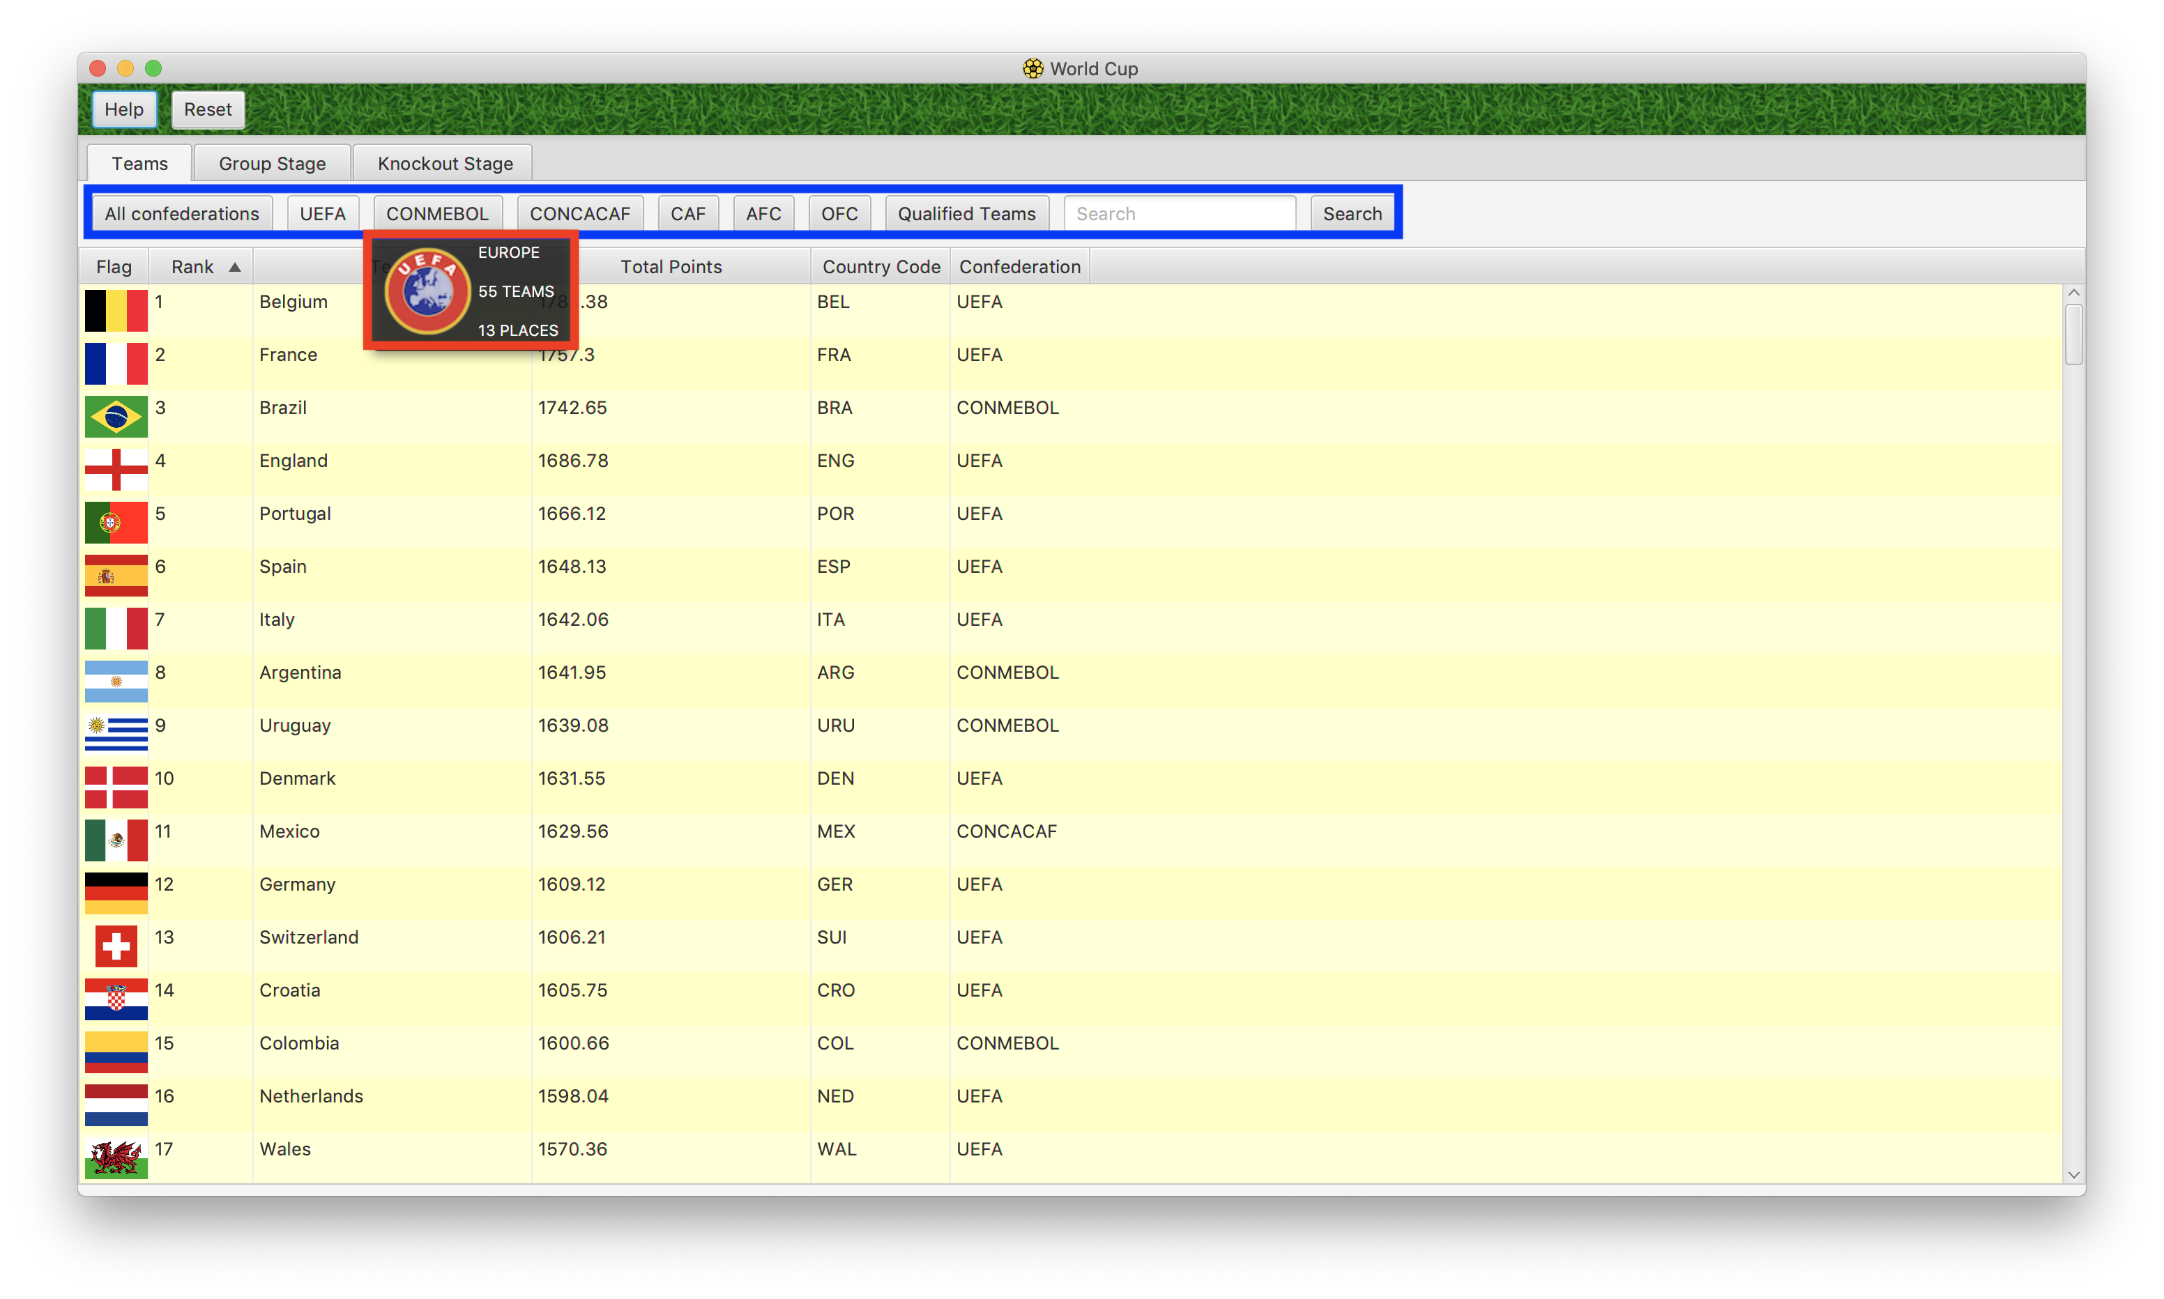
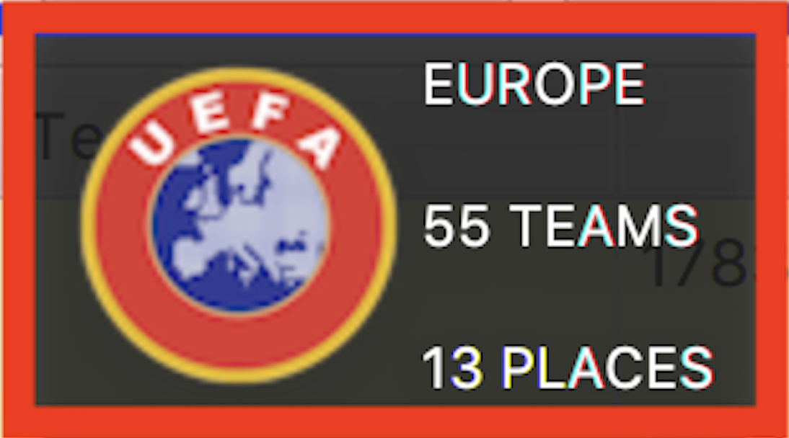
Teams Tab
All teams are represented as rows inside a table.
There are columns that display a team’s name, rank, total points, country code, and confederation
There’s a button bar at the top.
If you click on a confederation the table will only display teams from that specific confederation.
If you hover a confederation instead of clicking, you’ll see more information such what regions it consists of, how many teams it has, and how many spots it has in the World Cup.

Slide 6
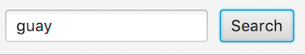
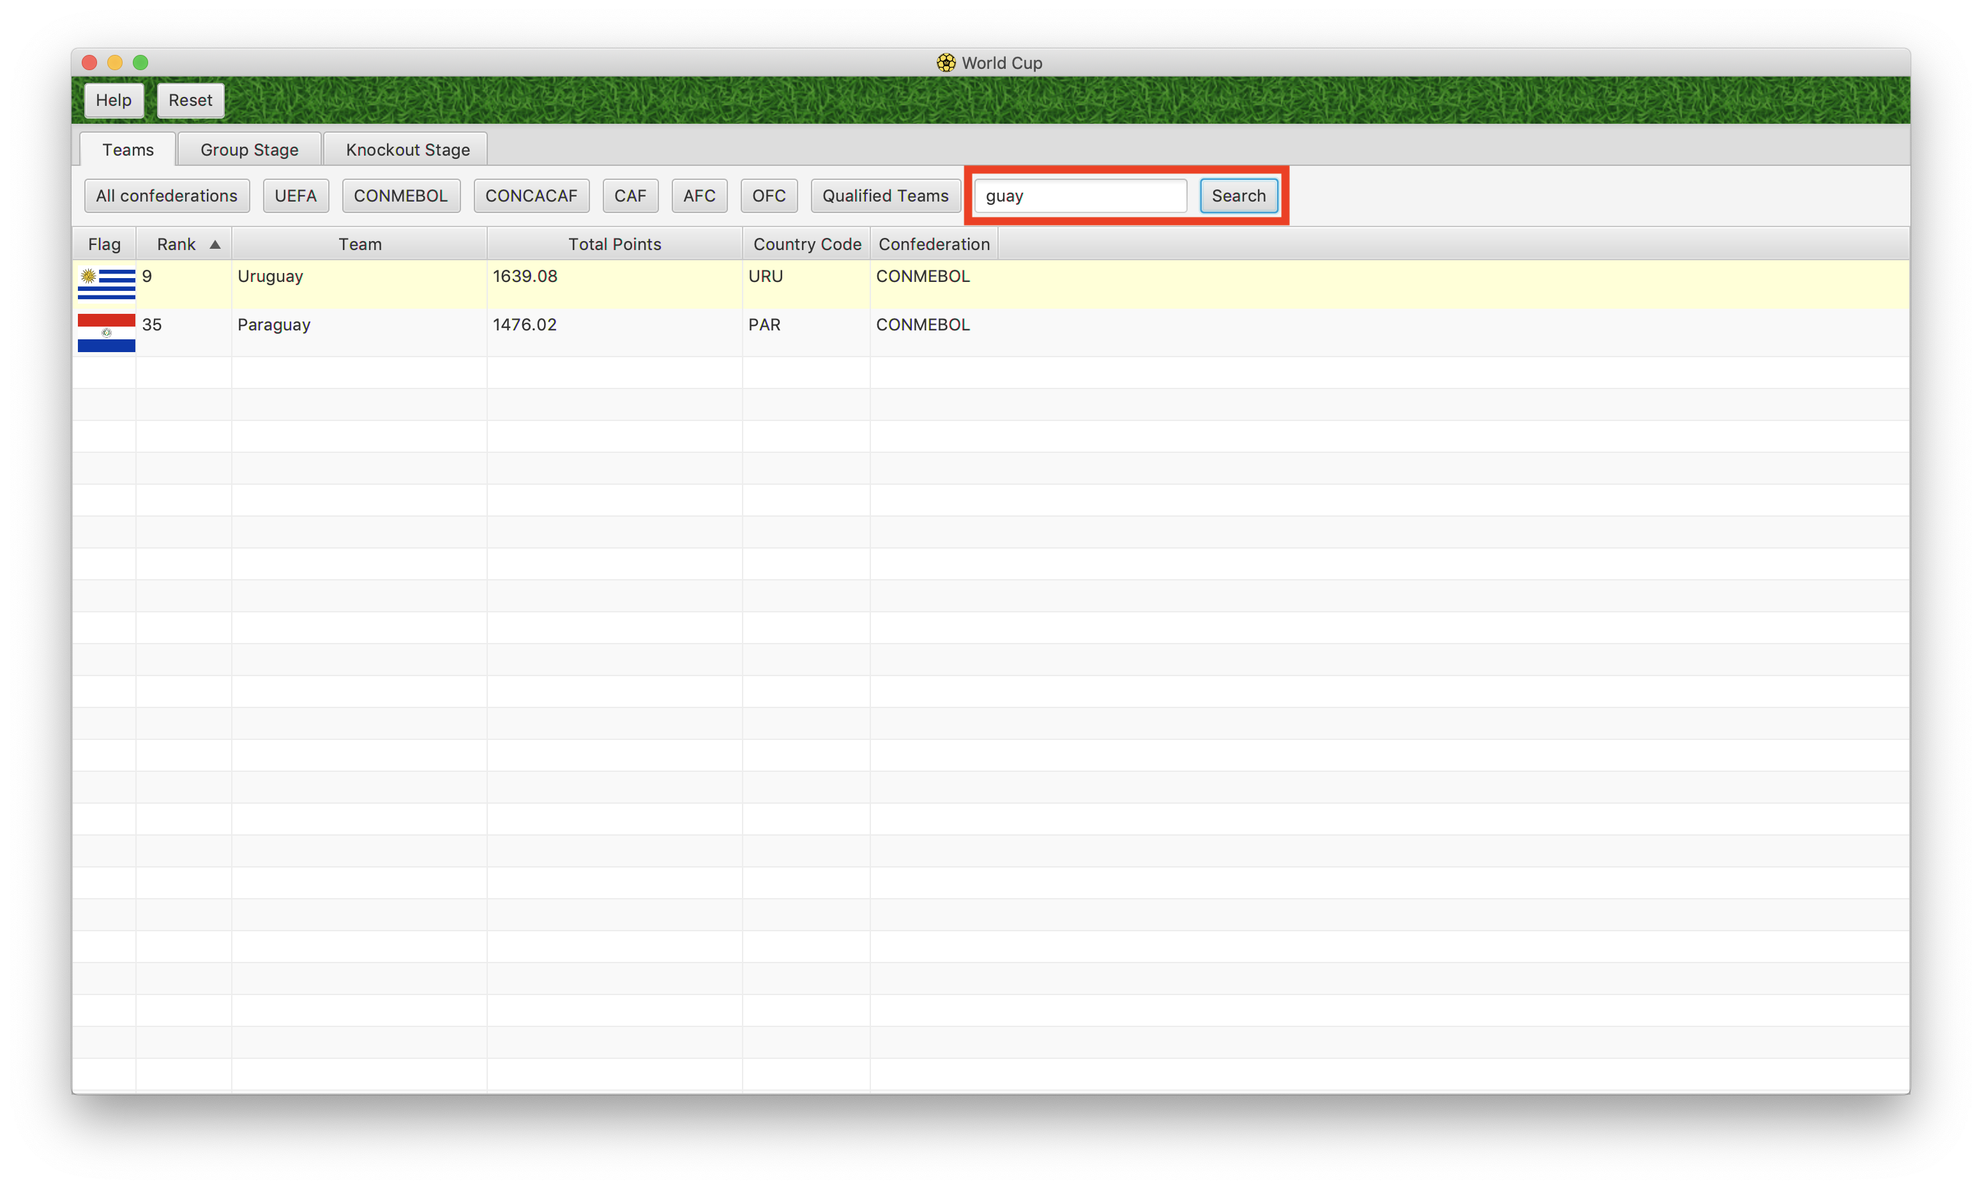
Teams Tab Continued
If you would like to find a specific team you can use the “Search” button to find it.
Simply type something in the search box and hit “Search”
If no team or country code matches the search you will see no results.
Teams that have qualified for the World Cup will be highlighted yellow
Teams that have not qualified for the World Cup will not be highlighted

Slide 7
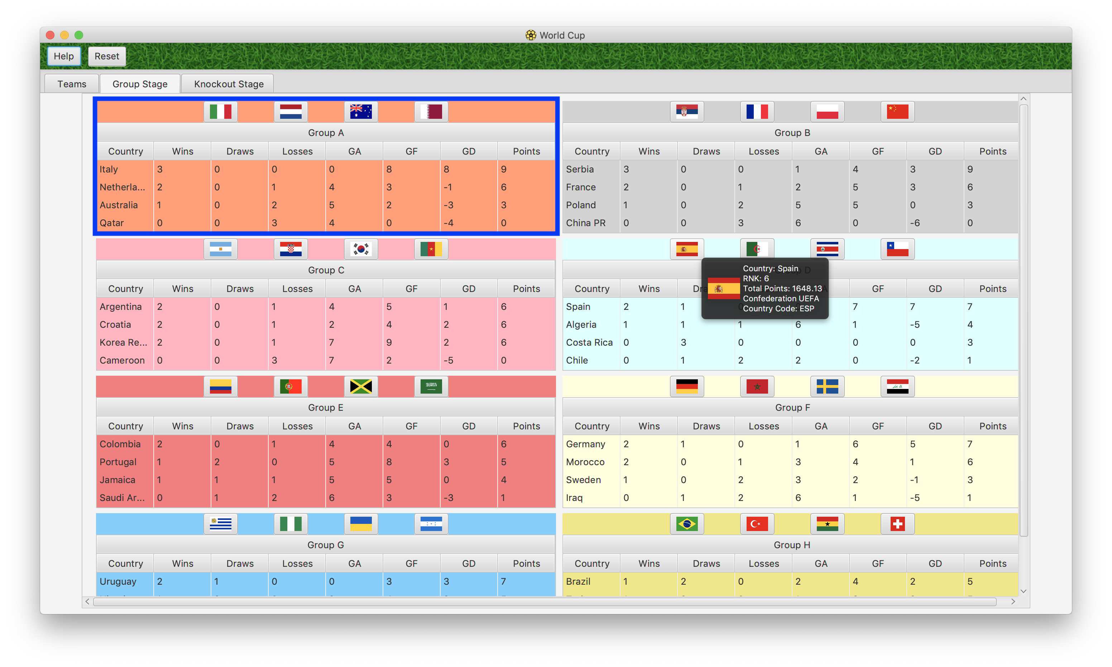
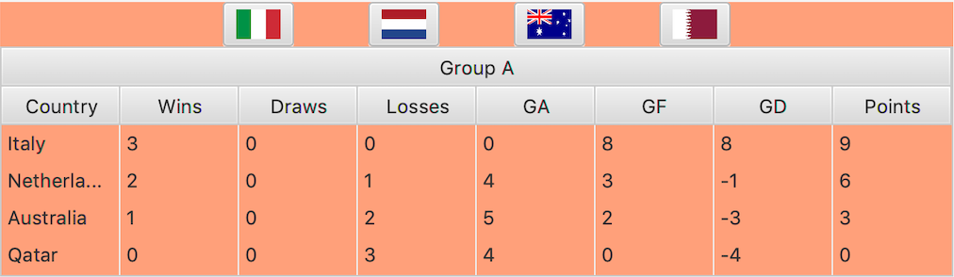
Groups Tab
Over here you can see all the groups in the World Cup
A table represents each group. Every row is a team
There are columns for the team’s name, wins, draws, losses, goals against, goals for, goal difference, and points

Slide 8
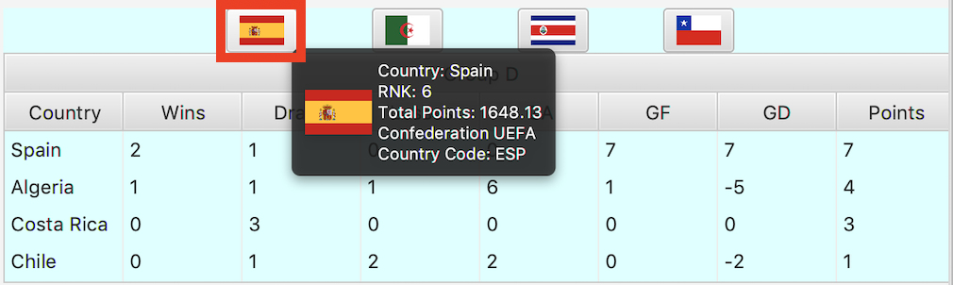
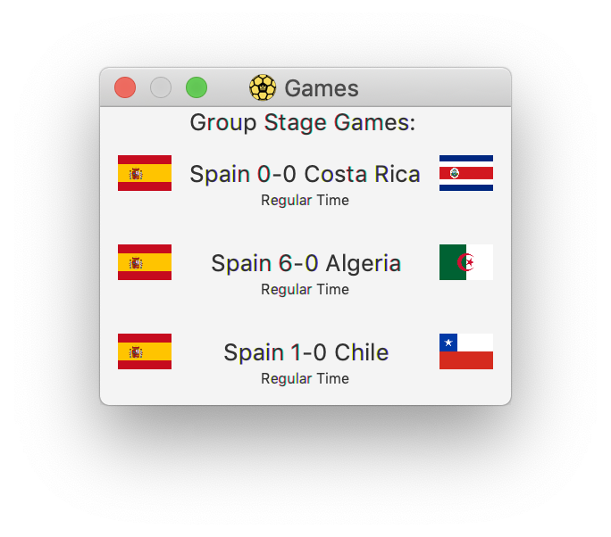
Groups Stage Continued…
On the top of the top of every group there’s a button bar with flags.
If you hover over a flag, you will see some information about that team.
If you click on a flag, a window displaying all the games a team has played will appear
The two teams with the highest number of points in each group will advance to the knockout stage.

Slide 9
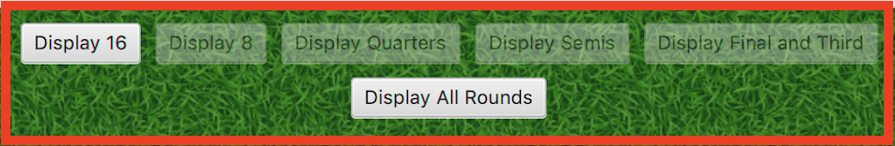
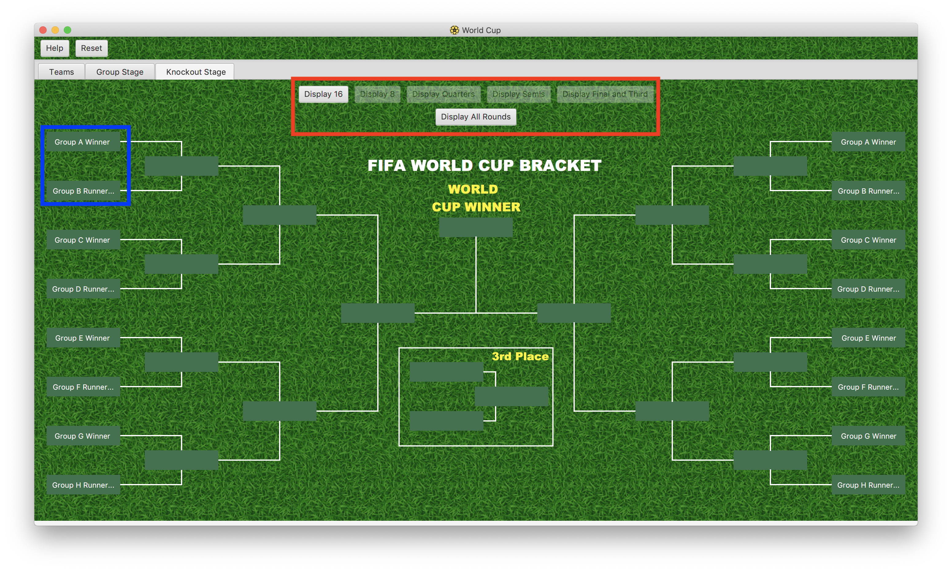
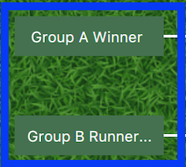
Knockout Pane
Unlike the other sections of the application, view each game one round at a time
At first the bracket will be empty, and the first round slots will indicate where each of the group winners go
If you don’t want to simulate each round one by one, you can simply hit “Display All Rounds” to see the results of the World Cup

Slide 10
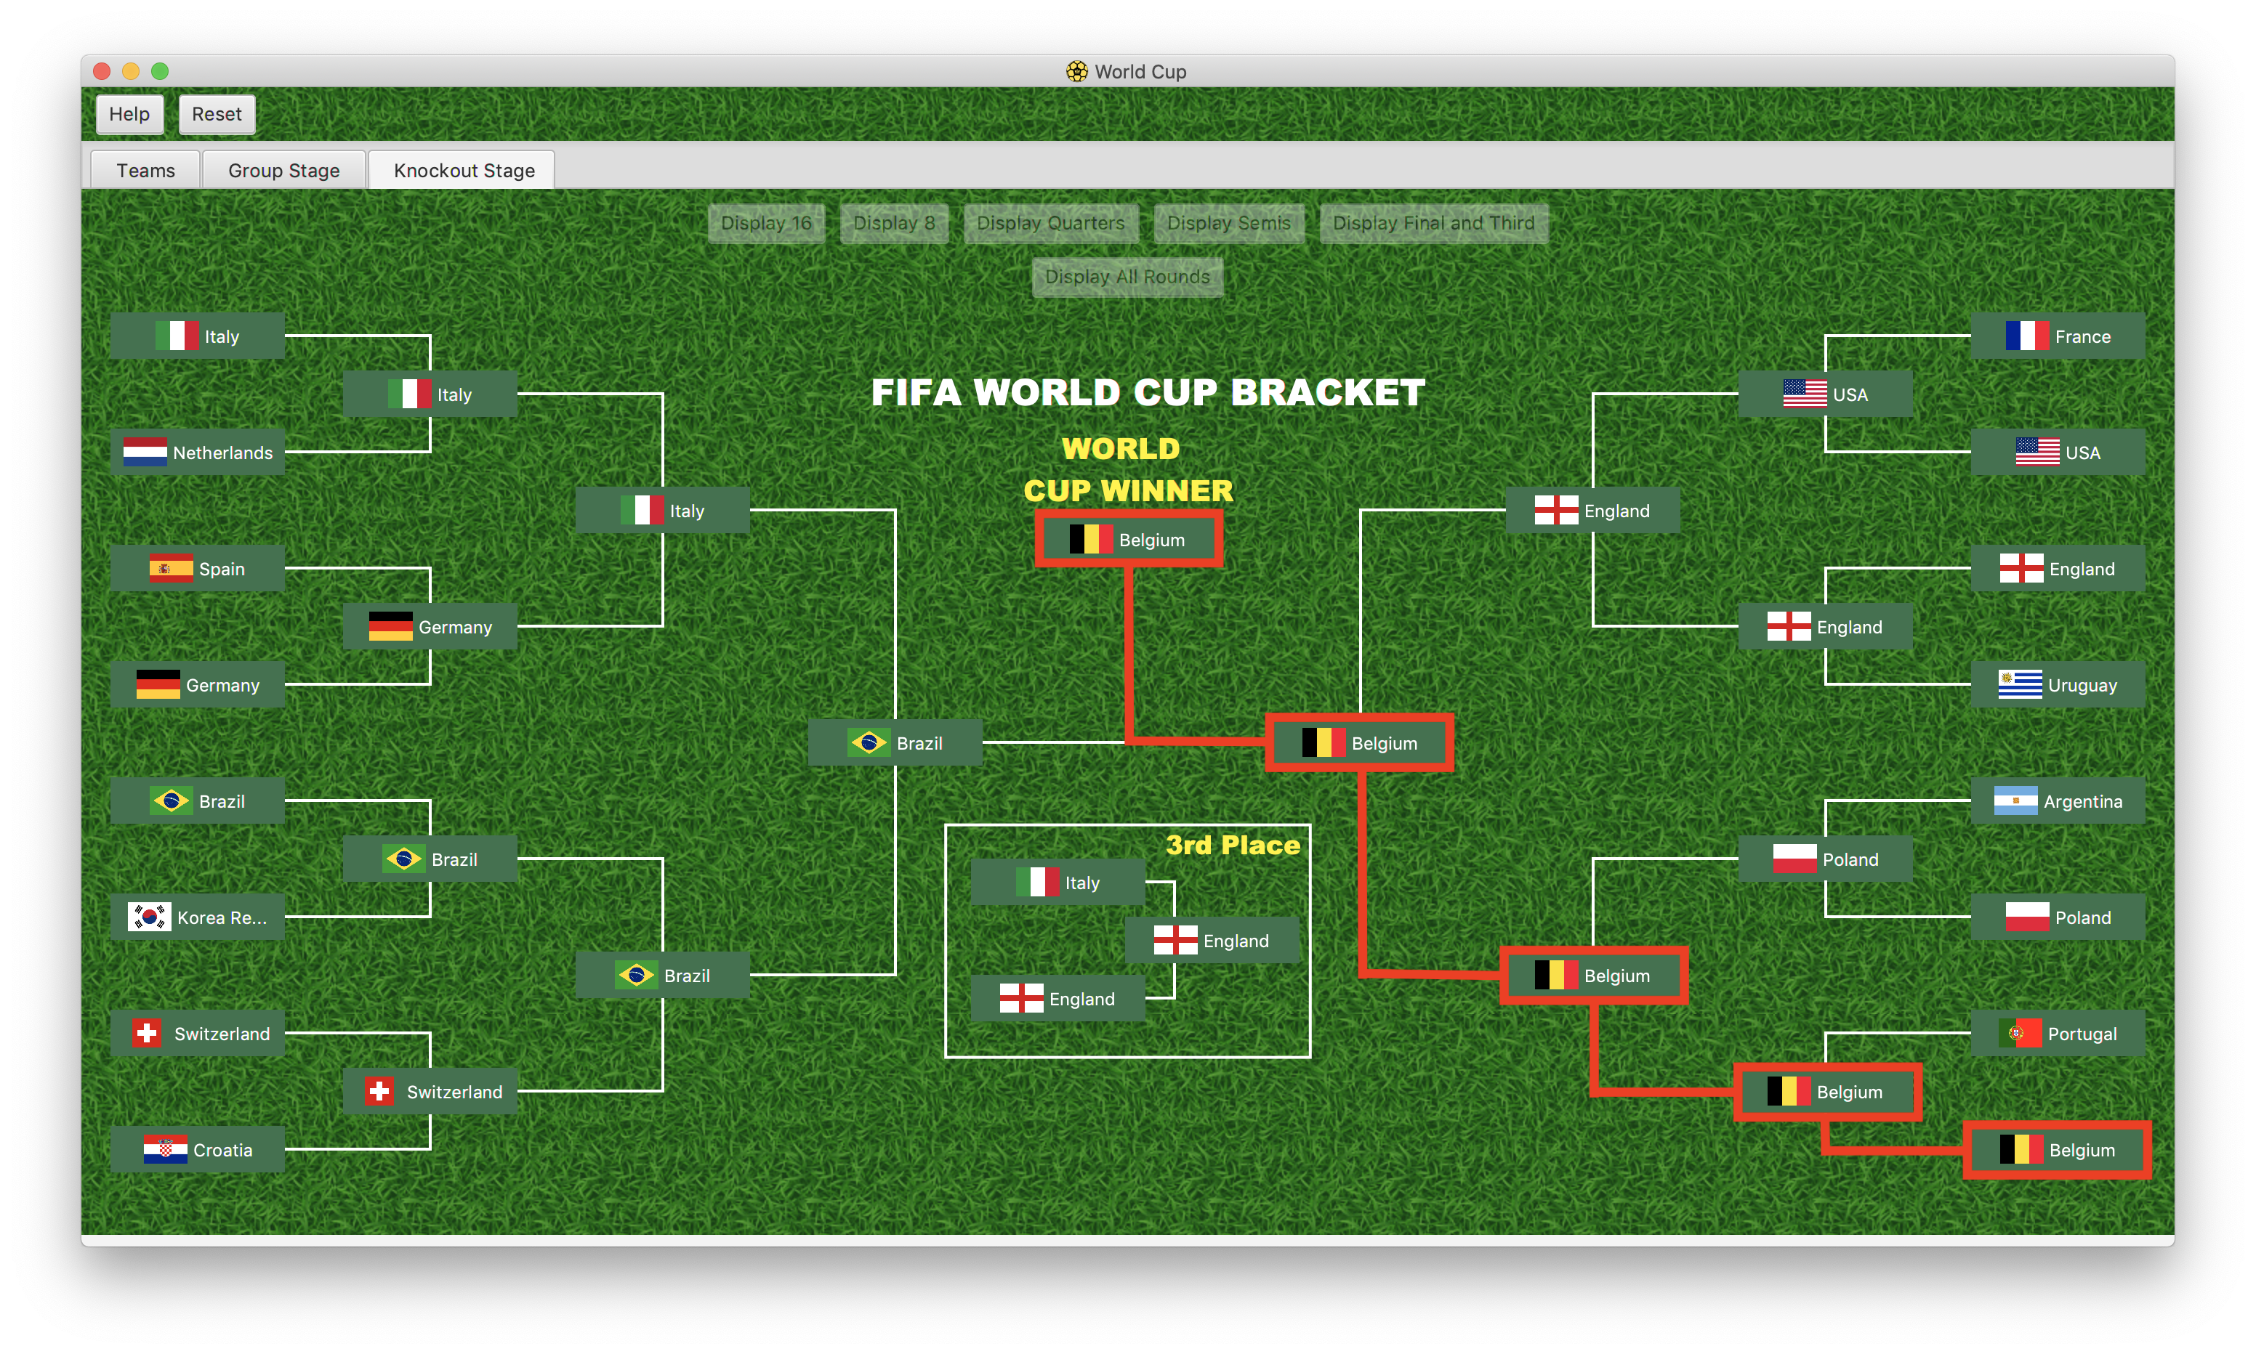
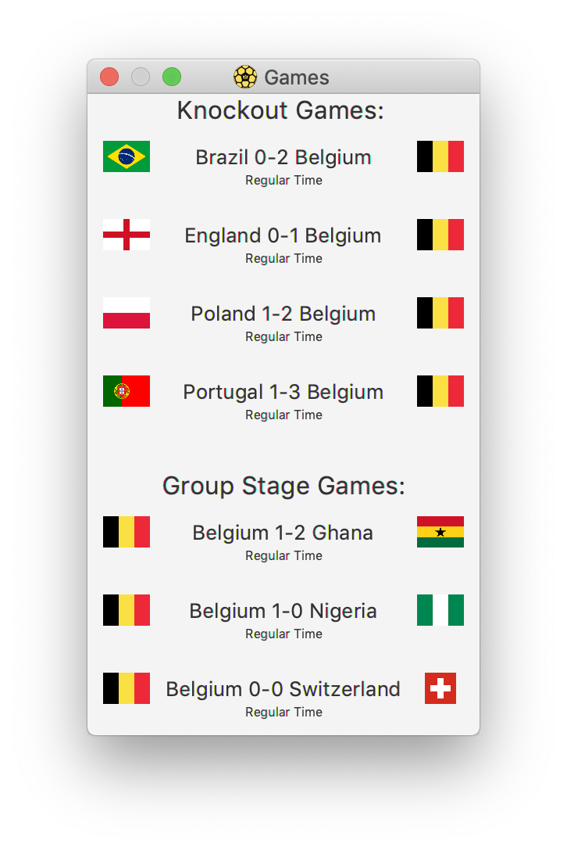
Knockout Pane Continued
Teams that win a match will continue into the next round.
Teams that lose will no longer be in the tournament
There is a match for the third place
If you click on a team a pop displaying its games from that point during the tournament will appear

